Slide 1
Get Started with Data Warehouses in Microsoft Fabric
Module 5

Slide 2
Data Warehouses
Analytical stores built on a relational schema to support SQL queries
Often use a denormalized, multidimensional schema
Centralizes and organizes data from different departments, systems, and databases into a single, unified view for analysis and reporting purpose
Model data using tables and views
Use T-SQL for DML (data manipulation), DDL (data definition, and DQL (data query) operations
Notes:
Data warehouses are analytical stores built on a relational schema to support SQL queries.
A data warehouse centralizes and organizes data from different departments, systems, and databases into a single, unified view for analysis and reporting purposes. Fabric's data warehouse provides full SQL semantics, including the ability to insert, update, and delete data in the tables.
Relational data warehouses are at the center of most enterprise business intelligence (BI) solutions. While the specific details may vary across data warehouse implementations, a common pattern based on a denormalized, multidimensional schema has emerged as the standard design for a relational data warehouse.
Tables in a data warehouse are typically organized in a way that supports efficient and effective analysis of large amounts of data. This organization is often referred to as dimensional modeling, which involves structuring tables into fact tables and dimension tables.

Slide 3
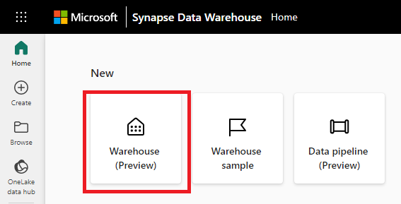
Data Warehouses in Fabric
Build a relational layer on top of physical data in the Lakehouse and expose it to analysis and reporting tools
Give you the ability to manipulate data with T-SQL
Distributed query processing engine
Compute and storage are decoupled
Autonomous allocation and relinquishing of resources to offer best in breed performance with automatic scale and concurrency built in
Notes:
Fabric's data warehouse experience allows you to transition from the lake view of the Lakehouse (which supports data engineering and Apache Spark) to the SQL experiences that a traditional data warehouse would provide. The Lakehouse gives you the ability to read tables and use the SQL endpoint, whereas the data warehouse enables you to manipulate the data.
In the data warehouse experience, you'll model data using tables and views, run T-SQL to query data across the data warehouse and Lakehouse, use T-SQL to perform DML operations on data inside the data warehouse, and serve reporting layers like Power BI
Microsoft Fabric introduces a lake centric data warehouse built on an enterprise grade distributed processing engine that enables industry leading performance at scale while eliminating the need for configuration and management. Through an easy to use SaaS experience that is tightly integrated with Power BI for easy analysis and reporting, Warehouse in Microsoft Fabric converges the world of data lakes and warehouses with a goal of greatly simplifying an organizations investment in their analytics estate. Data warehousing workloads benefit from the rich capabilities of the SQL engine over an open data format, enabling customers to focus on data preparation, analysis and reporting over a single copy of their data stored in their Microsoft OneLake.
Fabric data warehouse is a fully managed, scalable, and highly available data warehouse that can be used to store and query data in the Lakehouse. Using the data warehouse, you're fully in control of creating tables, loading, transforming, and querying data using either the Fabric portal or T-SQL commands. You can use SQL to query and analyze the data, or use Spark to process the data and create machine learning models.
Warehouses in Microsoft Fabric leverage an industry-leading distributed query processing engine, which provides customers with workloads that have a natural isolation boundary. There are no knobs to turn with the autonomous allocation and relinquishing of resources to offer best in breed performance with automatic scale and concurrency built in. True isolation is achieved by separating workloads with different characteristics, ensuring that ETL jobs never interfere with their ad hoc analytics and reporting workloads.

Slide 4
Recommended Use Cases
Data Warehousing for enterprise use
Data Warehousing supporting departmental, business unit or self service use
Structured data analysis in T-SQL with tables, views, procedures and functions and Advanced SQL support for BI
SELECT * FROM ContosoLakehouse.dbo.ContosoSalesTable AS Contoso
INNER JOIN Affiliation
ON Affiliation.AffiliationId = Contoso.RecordTypeID;
Notes:
The Synapse Data Warehouse or Warehouse is a 'traditional' data warehouse and supports the full transactional T-SQL capabilities like an enterprise data warehouse. As opposed to SQL Endpoint, where tables and data are automatically created, you are fully in control of creating tables, loading, transforming, and querying your data in the data warehouse using either the Microsoft Fabric portal or T-SQL commands.
It is best for SQL Developers or citizen developers.
Recommended use cases include:
Data Warehousing for enterprise use
Data Warehousing supporting departmental, business unit or self service use
Structured data analysis in T-SQL with tables, views, procedures and functions and Advanced SQL support for BI

Slide 5
Limitations Compared to SQL Server
The following are not available or would cause issues:
Computed columns
Partitioned tables
Temporary tables
User-defined types
Identity Columns
Latin1_General_100_BIN2_UTF8 is the default and only supported collation
Statistical updating doesn't happen automatically.
PRIMARY KEY and UNIQUE constraint are only supported when NONCLUSTERED and NOT ENFORCED are both used
FOREIGN KEY is only supported when NOT ENFORCED is used
Notes:
The following list shows some of the table features that aren't currently supported. During preview, this list is subject to change.
Computed columns
Indexed views
Partitioned tables
Sequence
Sparse columns
Surrogate keys on number sequences with Identity columns
Synonyms
Temporary tables
Triggers
Unique indexes
User-defined types
Currently, Latin1_General_100_BIN2_UTF8 is the default and only supported collation for both tables and metadata.
The query optimizer uses column-level statistics when it creates the plan for executing a query. To improve query performance, it's important to have statistics on individual columns, especially columns used in query joins. Warehouse supports automatic creation of statistics.
Statistical updating doesn't happen automatically. Update statistics after a significant number of rows are added or changed. For instance, update statistics after a load.
Warehouse in Microsoft Fabric supports these table constraints:
PRIMARY KEY is only supported when NONCLUSTERED and NOT ENFORCED are both used.
UNIQUE constraint is only supported when NONCLUSTERED and NOT ENFORCED is used.
FOREIGN KEY is only supported when NOT ENFORCED is used.
Warehouse doesn't support default constraints at this time.

Slide 6
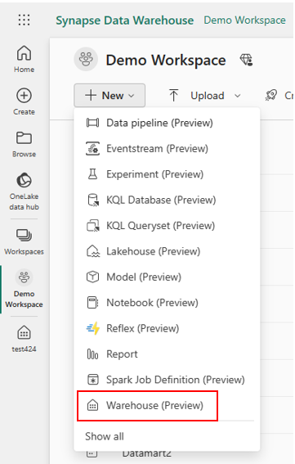
Create a Fabric Data Warehouse
Create your data warehouse directly in Fabric from the Home hub, the Create hub or within a workspace
Create and query tables using T-SQL directly in the Fabric interface or via clients such as SSMS or ADS (Azure Data Studio)
Adds tables and views to the default Power BI semantic model
Notes:
The first hub in the left navigation menus is the Home hub. You can start creating your warehouse from the Home hub by selecting the Warehouse card under the New section. An empty warehouse is created for you to start creating objects in the warehouse. You can use either a sample data set to get a jump start or load your own test data if you prefer.
Another option available to create your warehouse is through the Create hub, which is the second hub in the left navigation menu.
You can create your warehouse from the Create hub by selecting the Warehouse card under the Data Warehousing section. When you select the card, an empty warehouse is created for you to start creating objects in the warehouse or use a sample to get started as previously mentioned.
To create a warehouse, navigate to your workspace, select + New and then select Warehouse to create a warehouse.
By default, all tables and views in the Warehouse are automatically added to the default Power BI semantic model. Users can also manually select tables or views from the Warehouse they want included in the model for more flexibility

Slide 7
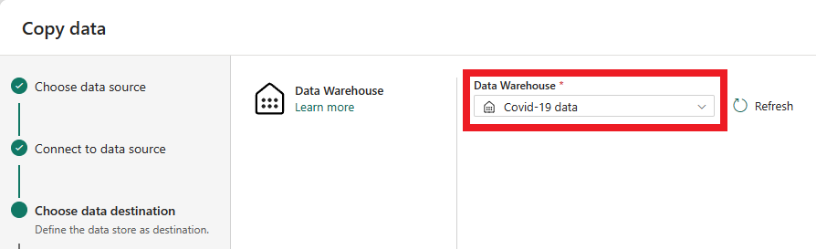
Ingest Data into a Fabric Data Warehouse
There are four options for data ingestion into a Warehouse:
COPY (Transact-SQL)
Data pipelines
Dataflows
Cross-warehouse ingestion
Notes:
You can ingest data into a Warehouse using one of the following options:
COPY (Transact-SQL): the COPY statement offers flexible, high-throughput data ingestion from an external Azure storage account. You can use the COPY statement as part of your existing ETL/ELT logic in Transact-SQL code.
Data pipelines: pipelines offer a code-free or low-code experience for data ingestion. Using pipelines, you can orchestrate robust workflows for a full Extract, Transform, Load (ETL) experience that includes activities to help prepare the destination environment, run custom Transact-SQL statements, perform lookups, or copy data from a source to a destination.
Dataflows: an alternative to pipelines, dataflows enable easy data preparation, cleaning, and transformation using a code-free experience.
Cross-warehouse ingestion: data ingestion from workspace sources is also possible. This scenario may be required when there's the need to create a new table with a subset of a different table, or as a result of joining different tables in the warehouse and in the lakehouse. For cross-warehouse ingestion, in addition to the options mentioned, Transact-SQL features such as INSERT...SELECT, SELECT INTO, or CREATE TABLE AS SELECT (CTAS) work cross-warehouse within the same workspace.
To decide which data ingestion option to use, you can use the following criteria:
Use the COPY (Transact-SQL) statement for code-rich data ingestion operations, for the highest data ingestion throughput possible, or when you need to add data ingestion as part of a Transact-SQL logic. For syntax, see COPY INTO (Transact-SQL).
Use data pipelines for code-free or low-code, robust data ingestion workflows that run repeatedly, at a schedule, or that involves large volumes of data. For more information, see Ingest data using Data pipelines.
Use dataflows for a code-free experience that allow custom transformations to source data before it's ingested. These transformations include (but aren't limited to) changing data types, adding or removing columns, or using functions to produce calculated columns. For more information, see Dataflows.
Use cross-warehouse ingestion for code-rich experiences to create new tables with source data within the same workspace. For more information, see Ingest data using Transact-SQL and Write a cross-database query.
The COPY statement in Warehouse supports only data sources on Azure storage accounts, with authentication using to Shared Access Signature (SAS), Storage Account Key (SAK), or accounts with public access. For other limitations, see COPY (Transact-SQL).

Slide 8
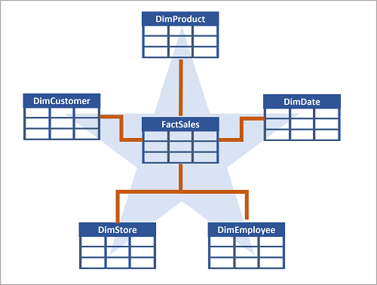
Common Data Warehouse Conventions
Batch data loads at regular intervals
Staging tables used to load data from multiple sources into a single destination table
Work tables used to perform data cleansing, data transformations, and data validation
Use custom schemas to organize data
Star Schema organizes data into fact and dimension tables
Notes:
Data is usually ingested to a warehouse at regular intervals, either hourly, daily, weekly, or monthly. This can be facilitated by scheduling a pipeline or notebook in Fabric.
A star schema organizes data into fact and dimension tables. Some tables are used for integration or staging data before moving to a fact or dimension table.
Warehouse supports the creation of custom schemas. Like in SQL Server, schemas are a good way to group together objects that are used in a similar fashion.

Slide 9
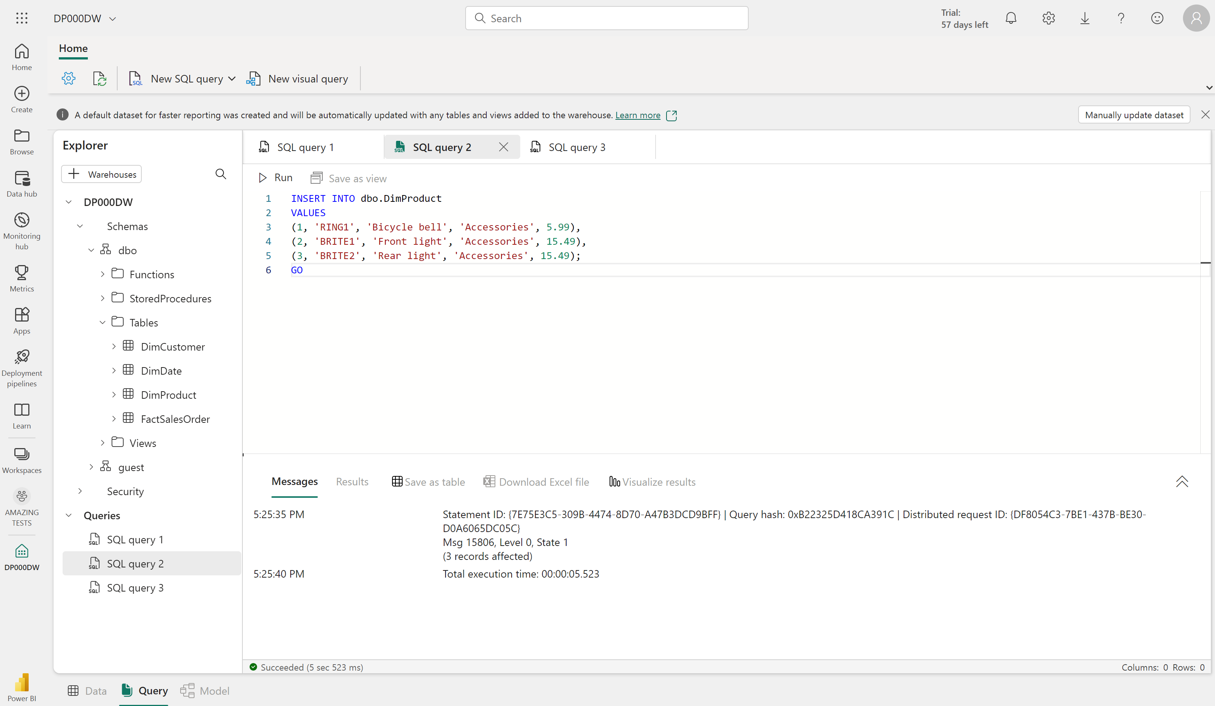
SQL Query Editor
Author and run your T-SQL queries in a web browser
Supports Intellisense, code completion, syntax highlighting, client-side parsing, and validation
Notes:
SQL query editor provides a query experience that includes Intellisense, code completion, syntax highlighting, client-side parsing, and validation. You can run Data Definition Language (DDL), Data Manipulation Language (DML) and Data Control Language (DCL) statements. If you've written T-SQL in SQL Server Management Studio (SSMS) or Azure Data Studio (ADS), you'll find it familiar.

Slide 10
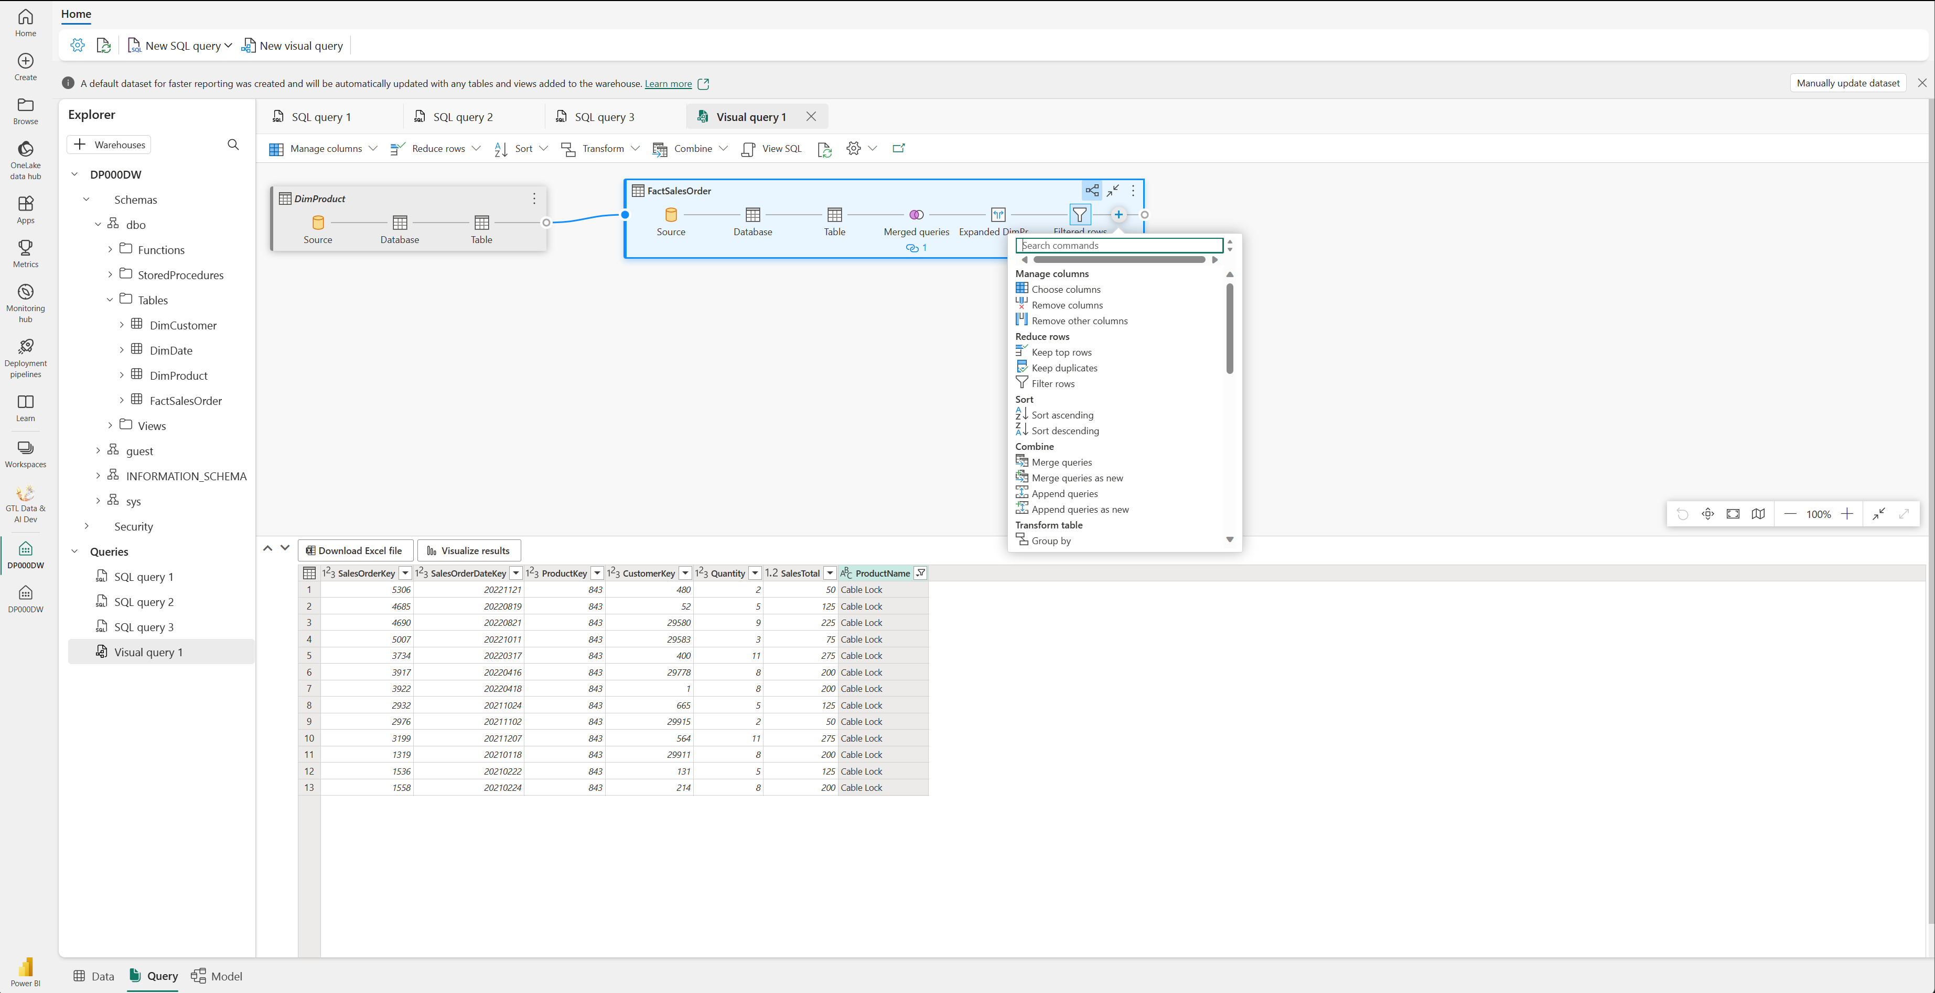
Visual Query Editor
Provides a no-code, drag-and-drop experience to create your queries
Similar to the Power Query online diagram view
Notes:
The Visual query editor provides a no-code, drag-and-drop experience to create your queries.
The Visual query editor provides an experience similar to the Power Query online diagram view. Use the New visual query button to create a new query.
Drag a table from your data warehouse onto the canvas to get started. You can then use the Transform menu at the top of the screen to add columns, filters, and other transformations to your query. You can use the (+) button on the visual itself to perform similar transformations. As you work on your visual query, the queries are automatically saved every few seconds. A "saving indicator" appears in your query tab to indicate that your query is being saved.

Slide 11
Security in a Fabric Data Warehouse
Role-based access control (RBAC) to control access to the warehouse and its data
Workspace roles
Admins, Members, and Contributors can read data through OneLake APIs, Spark, or SQL Endpoints and connect to the SQL endpoint
Viewers can connect to the SQL endpoint
Item permissions granted via T-SQL or the Fabric portal:
Read: Allows the user to CONNECT using the SQL connection string.
ReadData: Allows the user to read data from any table/view within the warehouse.
ReadAll: Allows user to read data the raw parquet files in OneLake that can be consumed by Spark.
Notes:
Microsoft Fabric permissions and granular SQL permissions work together to govern Warehouse access and the user permissions once connected.
Warehouse connectivity is dependent on being granted the Microsoft Fabric Read permission, at a minimum, for the Warehouse.
Microsoft Fabric item permissions enable the ability to provide a user with SQL permissions, without needing to grant those permissions within SQL.
Microsoft Fabric workspace roles provide Microsoft Fabric permissions for all warehouses within a workspace.
Granular user permissions can be further managed via T-SQL.
Workspace roles are used for development team collaboration within a workspace. Role assignment determines the actions available to the user and applies to all items within the workspace.
Assigning users to the various workspace roles provides the following capabilities: Admin: Grants the user CONTROL access for each Warehouse and SQL Endpoint within the workspace, providing them with full read/write permissions and the ability to manage granular user SQL permissions. Allows the user to see workspace-scoped session, monitor connections and requests in DMVs via TSQL, and KILL sessions.
Member: Grants the user CONTROL access for each Warehouse and SQL Endpoint within the workspace, providing them with full read/write permissions and the ability to manage granular user SQL permissions.
Contributor: Grants the user CONTROL access for each Warehouse and SQL Endpoint within the workspace, providing them with full read/write permissions and the ability to manage granular user SQL permissions.
Viewer: Grants the user CONNECT permissions for each Warehouse and SQL Endpoint within the workspace. Viewers can be granted granular SQL permissions to read data from tables/views using T-SQL.

Slide 12
Summary
Analytical store with data stored in Delta files in OneLake
Uses T-SQL to query and create objects
Distributed query engine
Separate storage and compute
Use the SQL Editor or Visual query Editor
Workspace roles, item permissions, and SQL permissions
Commonly designed to contain a star schema
Notes:
In this module, we have seen that the Fabric data warehouse is built on top of the Fabric Lakehouse technology. The data for the warehouse is stored in OneLake.
The warehouse uses a distributed query engine that is separate from the storage in OneLake
SQL is used to create objects, manipulate data, and query data.
Queries can be written using a SQL Editor or the visual query editor for a low-code experience. Other SQL clients such as SSMS and ADS can be used as well.
Permissions can be granted through workspace roles, item permissions, or SQL permissions
Warehouses are commonly used as the serving layer for a star schema to support reporting and analytics.

Slide 13

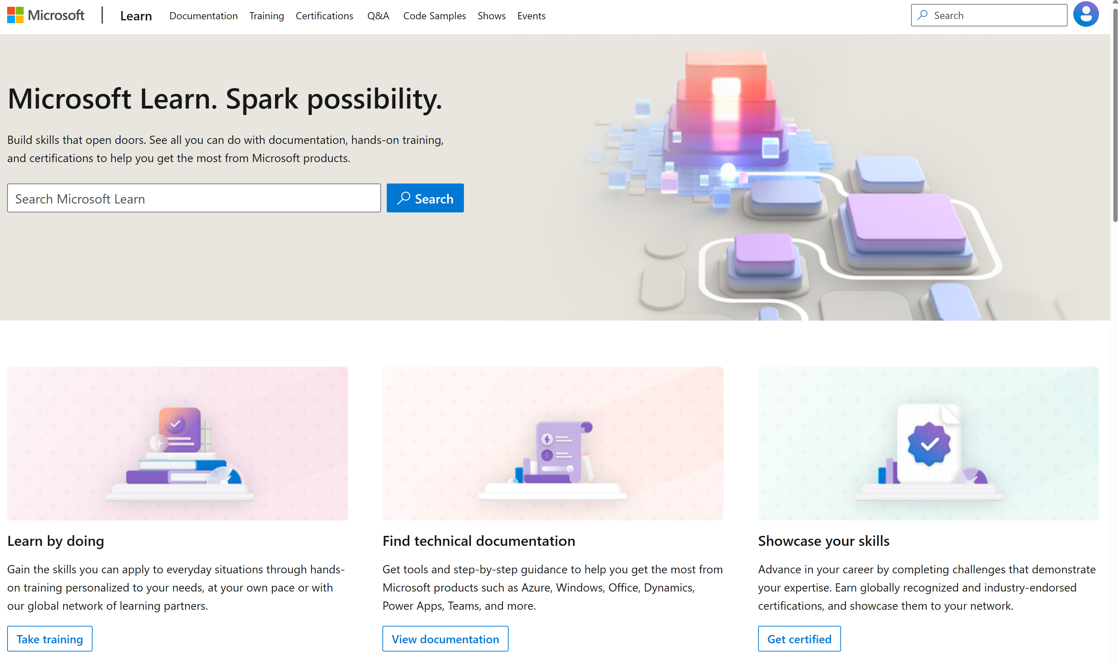
Microsoft Learn Demo
Microsoft Learn: Build skills that open doors in your career

Slide 14
Readiness and Enablement Links
The Microsoft Federal Team is here to help you accelerate customers' digital transformation. Microsoft Federal has tailored to make your organizations skilling journey successful. From the Business Decision Maker to the technical community and end-users, Microsoft provides customers with access to endless skilling resources. Below you will find links to these resources:
Get training tailored to your organization's needs: Find learning paths for specific roles in your organization, plus course recommendations based on technology, skill level, and solution area: Training | Learning Portal (microsoft.com)
Events Calendar - US Partner Community Blog – Microsoft
In addition to the above, the Microsoft Federal Team can address the needs of your non-technical community of your learners through:
Skilling Hours - Readiness and Enablement: Skilling our Federal Customers and Partners (office.com)
Microsoft Learning Portal: A closer look at Azure through training modules and gamified learning
Microsoft Learning Portal
Additional Learning Resources:
Get started with Azure – Introduction | Microsoft Azure
Microsoft Learn (path-based)
Exam-based: Select filters: Azure, D365, M365, Power Platform, and more
Microsoft Virtual Training Days – Virtual Instructor Led
Microsoft Technology Center - Work through your Account Manager
Home - Microsoft Tech Community
Microsoft Reactor | Microsoft Developer – Virtual Instructor Led

